Slide 1
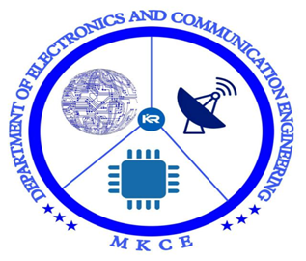


Technical Presentation
Microwave Engineering
(18ECC305J)

Slide 2
Microwave Communication
Systems

Slide 3
Synopsis
Microwave Communication Systems
Terrestial Systems
Block diagram of a Terrestial Systems
Terminal systems
Base band frequency limits
Atmospheric Refraction

Slide 4
Microwave Communication Systems
Microwaves are used in wireless communication to accommodate an increased number of channels with a high signal-to-noise power ratio.
Since the bandwidth can be a small fraction of the microwave carrier frequency fc, by using a higher carrier frequency, the overall system bandwidth can be increased, and more distinct channels can be transmitted

Slide 5
Terrestrial Systems
Since ground-based LOS distance is limited due to the attenuation of microwaves caused by the geographical profile, trees, buildings, etc., long-distance microwave communication is achieved through a multisection radio relay system.
It consists of two terminal stations and a number of repeater stations spaced at intervals of about 32-80 km, each of which amplifies the microwave signals to make up for transmission losses in space and retransmits again for the next stage.
A basic block diagram of the terrestrial microwave communication system

Slide 6
Block Diagram
Multiplexed
base-band signal
Repeater
Multiplexed
base-band signal
Basic Block Diagram of a Terrestrial microwave communication systems

Slide 7
Terminal Systems
FDM is more commonly used in that a number of telephone channels (300 Hz-3.4 kHz) are transmitted on the same microwave carrier by FM.
The telephone channels are arranged side by side in a base band at intervals of 4 kHz .The base-band frequency limits.

Slide 8
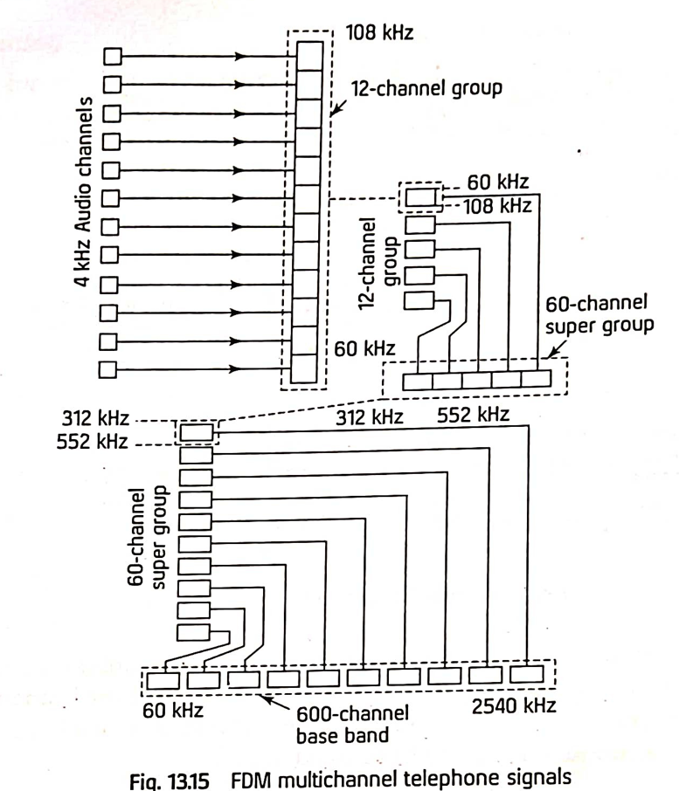
FDM multichannel telephone signals

Slide 9
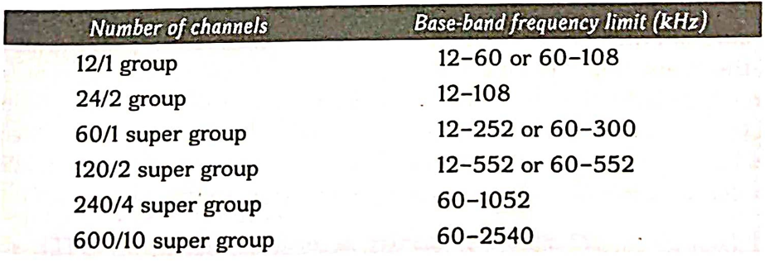
Base band frequency limits

Slide 11
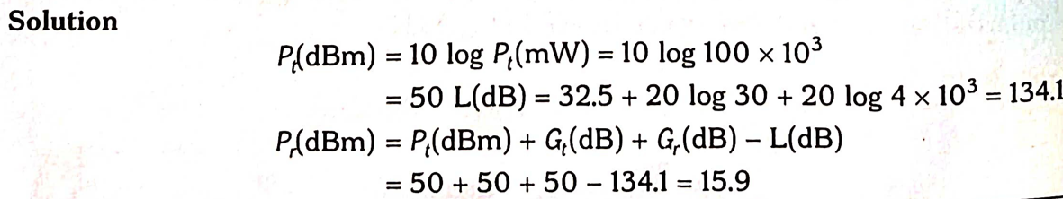

Slide 12
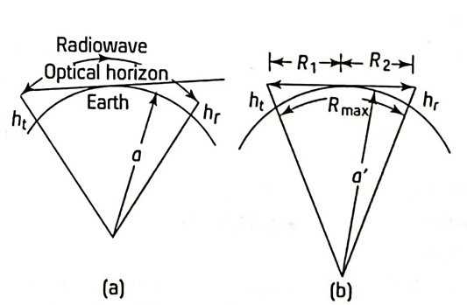
Atmospheric Refraction
Effect of atmospheric refraction

Slide 13
Continuation….
Since the dielectric constant of the atmosphere changes, the refractive index of the atmosphere decreases with increase in height above the earth's surface.
The propagation path of microwaves, h_{t} rangle therefore, bends towards the earth .
Since the change in refractive index is very small, such a curved ray path can be modelled by an equivalent straight-ray path over a spherical earth of radius a' greater than radius a of the original earth producing same result, for the received signal, where a^ prime >> (4/3) * a With this model, the maximum distance R max between a transmitter and a receiver, is a function of antenna heights above ground when the ray path just grazes the equivalent earth's surface. This distance R max is called radio horizon.

Slide 14


